Slide 1
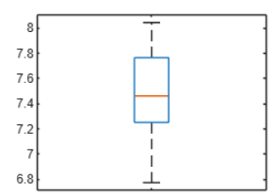
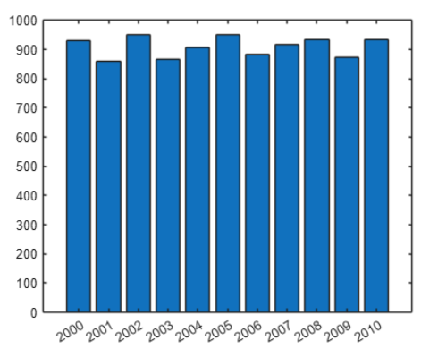
Problem Statement
You have a mission to help uncover hidden patterns in Mathtown’s weather data. Each challenge requires your data analysis skills to solve real-world problems.
Data was collected every day from 2000-2010 on the following 6 parameters:
AirTemperature
RainfallFlux
SnowfallFlux
SpecificHumidity
SurfAirPressure
WindSpeed

Slide 2
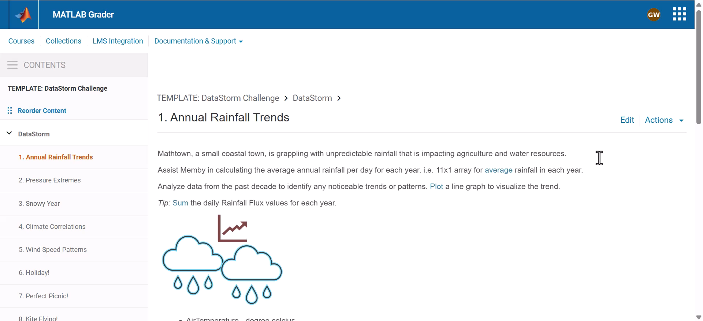
To view the dataset and test code, Open in MATLAB Online

